Slide 1
Instructions for R, Rstudio, and Package loading
Lecture one
Alexander McLain

Slide 2
Instructions
Users must install R before installing RStudio. However, R does not require the installation of RStudio. In this presentation, we will show how to download and install for both Windows and Mac. Please follow the instruction step by step carefully.
Specifically, you will learn (in this order)
Where could you download R installation file
How to install R after downloading installation file
What actions to test the completeness of your installation
Then, same Where, How, and What for Rstudio

Slide 3
Where to Download R?

Slide 4
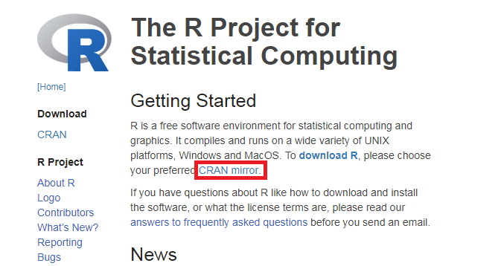
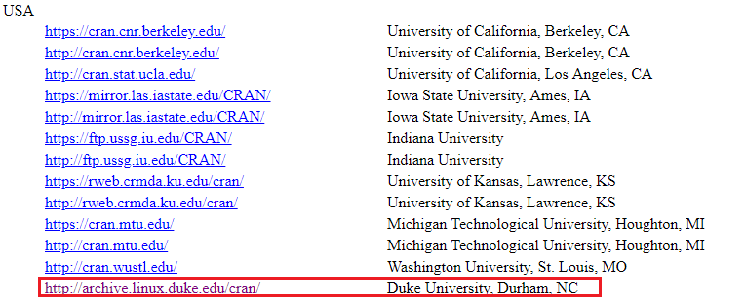
Where to download R - Choosing Mirror
Website: https://www.r-project.org/
Click CRAN mirror to choose the engine that closest to you (here, Duke University, Durham, NC as an example)

Slide 5
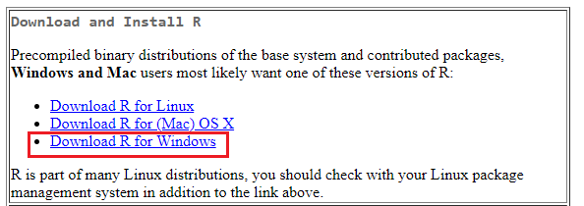
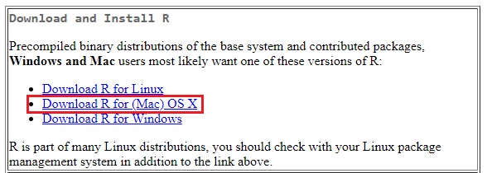
Where to download R - Choosing System
For Windows Users
For Mac Users
Click Download R for Windows
Click Download R for (Mac)…

Slide 6
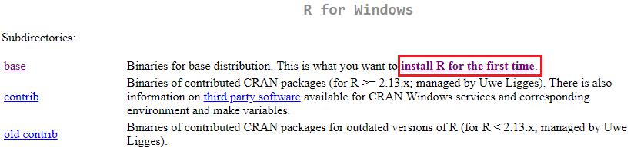
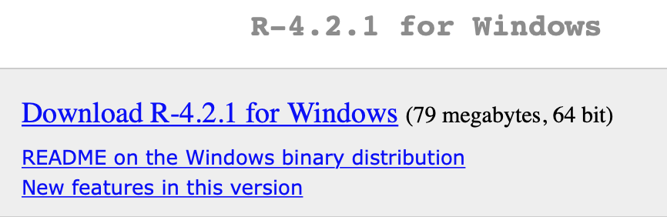
Where to download R – Details for Windows
Click install R for the first time
Click Download R x.x.x (Current version: 4.2.1) for Windows

Slide 7
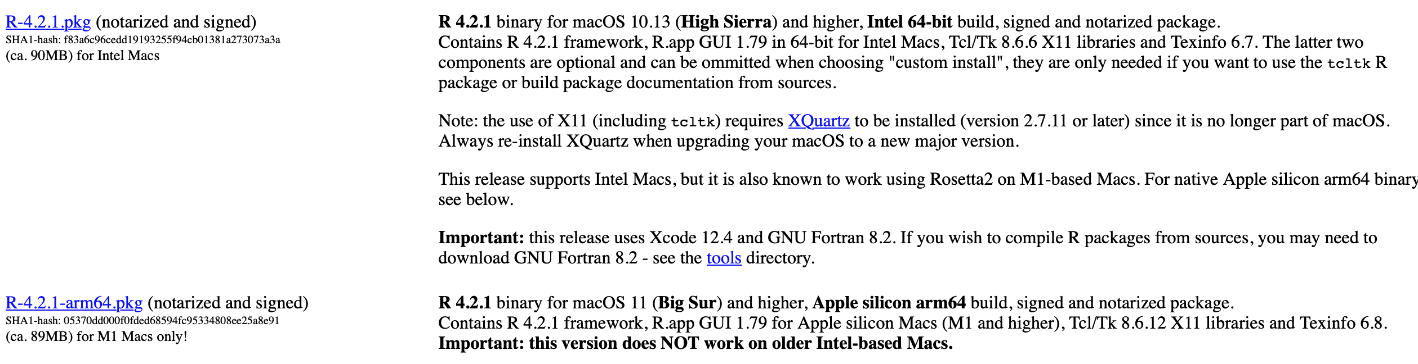
Where to download R – Details for Mac
To install for a Mac, it’s a little more complicated. The version to download depends on the chip in your computer.

Slide 8
How to Install R?

Slide 9
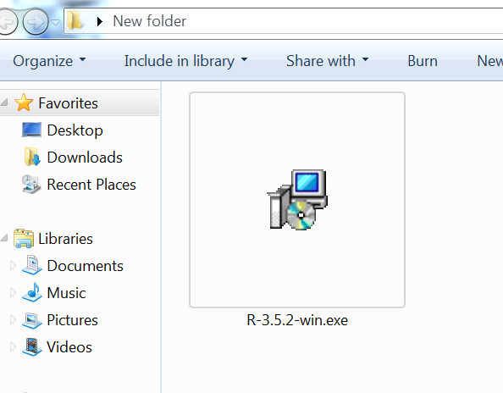
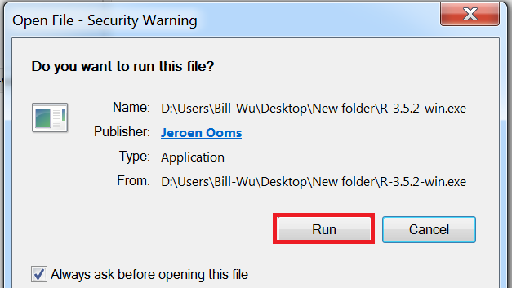
How to Install R – for Windows
Step 1
Step 2
Double click the installation file you just downloaded
Click Run when being asked for security warning

Slide 10
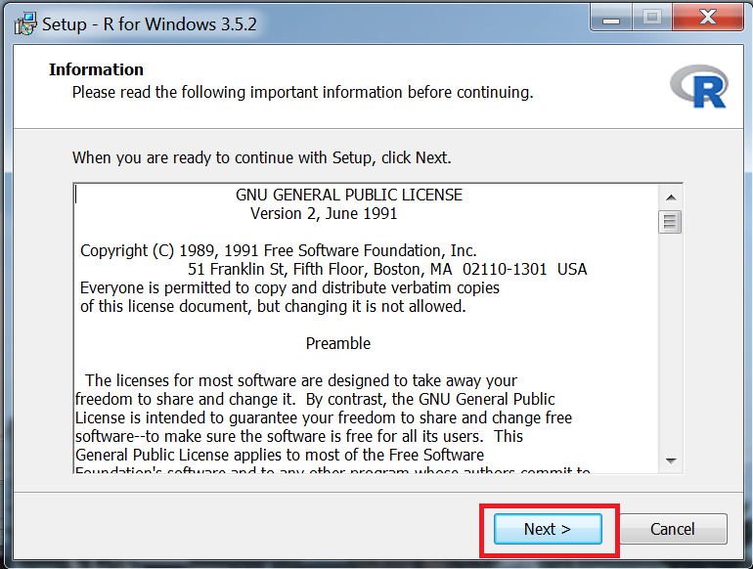
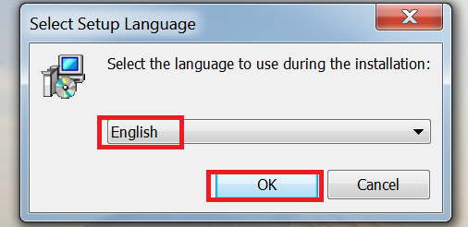
How to Install R – for Windows
Step 3
Step 4
Select language then press ok
Press next in information checking page

Slide 11
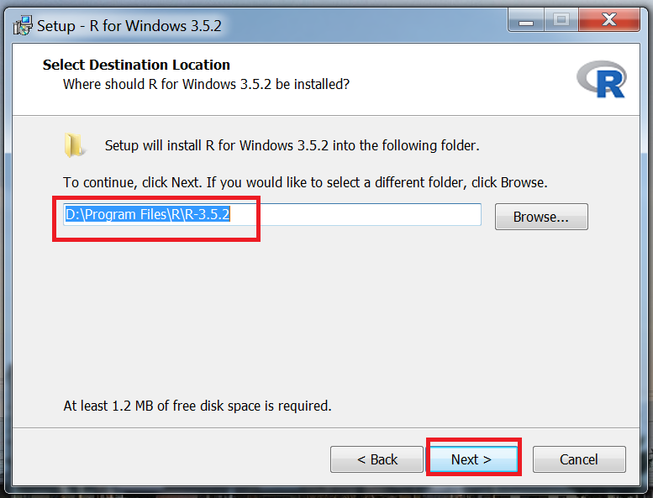
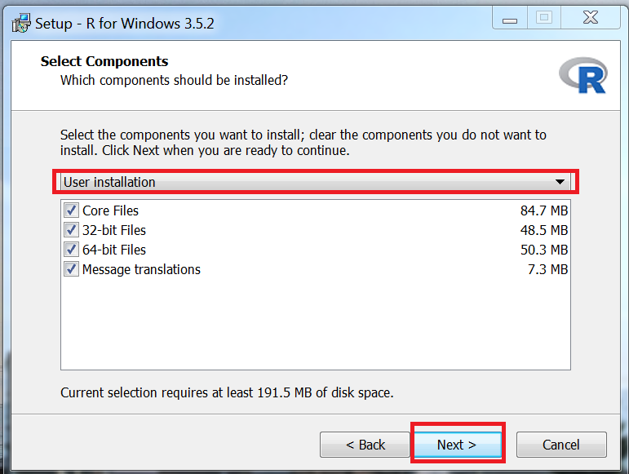
How to Install R – for Windows
Step 5
Step 6
Select destination location then press next
Select your computer system (x32/64) then press next

Slide 12
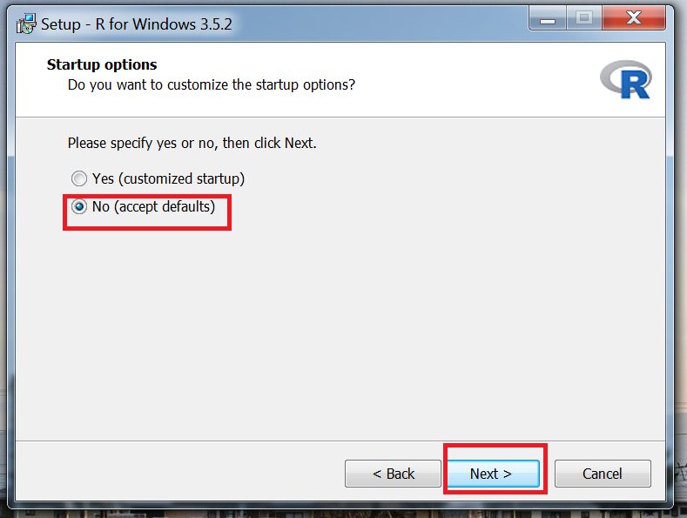
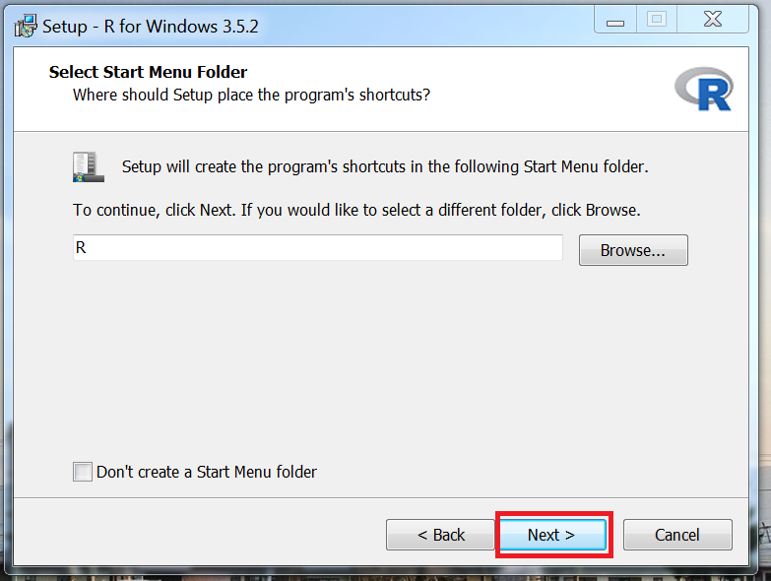
How to Install R – for Windows
Step 7
Step 8
Choose default setting in startup option page
Just click next (don’t change anything)

Slide 13
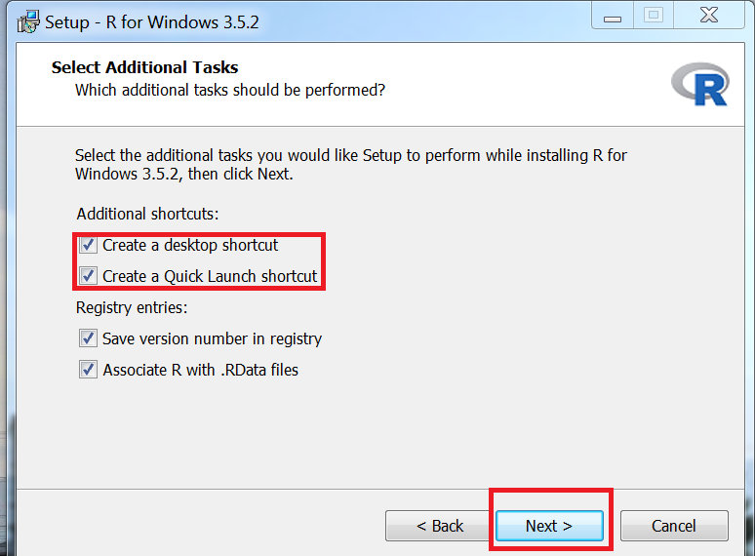
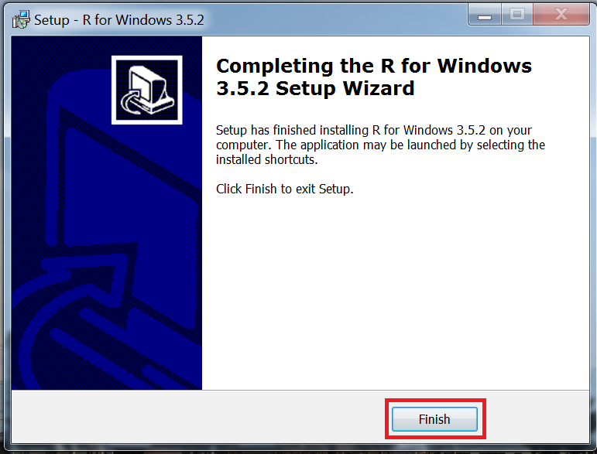
How to Install R – for Windows
Step 9
Step 10
Check create shortcut at desktop and for quick launch
Click finish to complete the installation

Slide 14
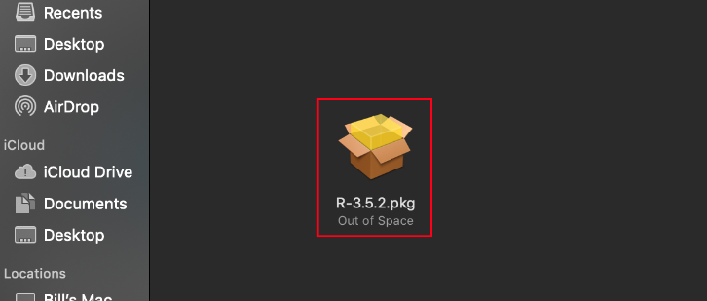
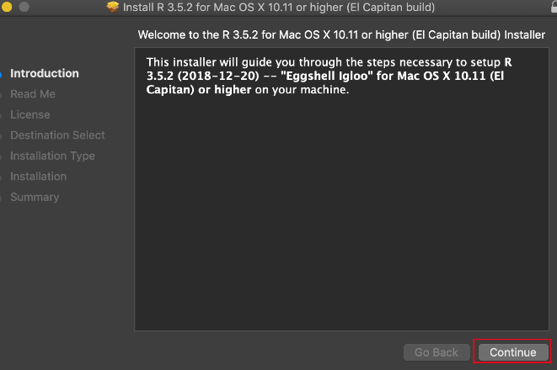
How to Install R – for Mac
Double click the installation file you just downloaded
Click continue (countlessly, sometimes with agree) until it says “The installation was successful” then close the installation file

Slide 15
What Actions to Test Completeness of Installation?

Slide 16
What Actions to Test
Open R: for Windows use either the x32, x64 version depending on your system.
Submit the following code to R Console (please copy and paste)
1+1
getwd()

Slide 17
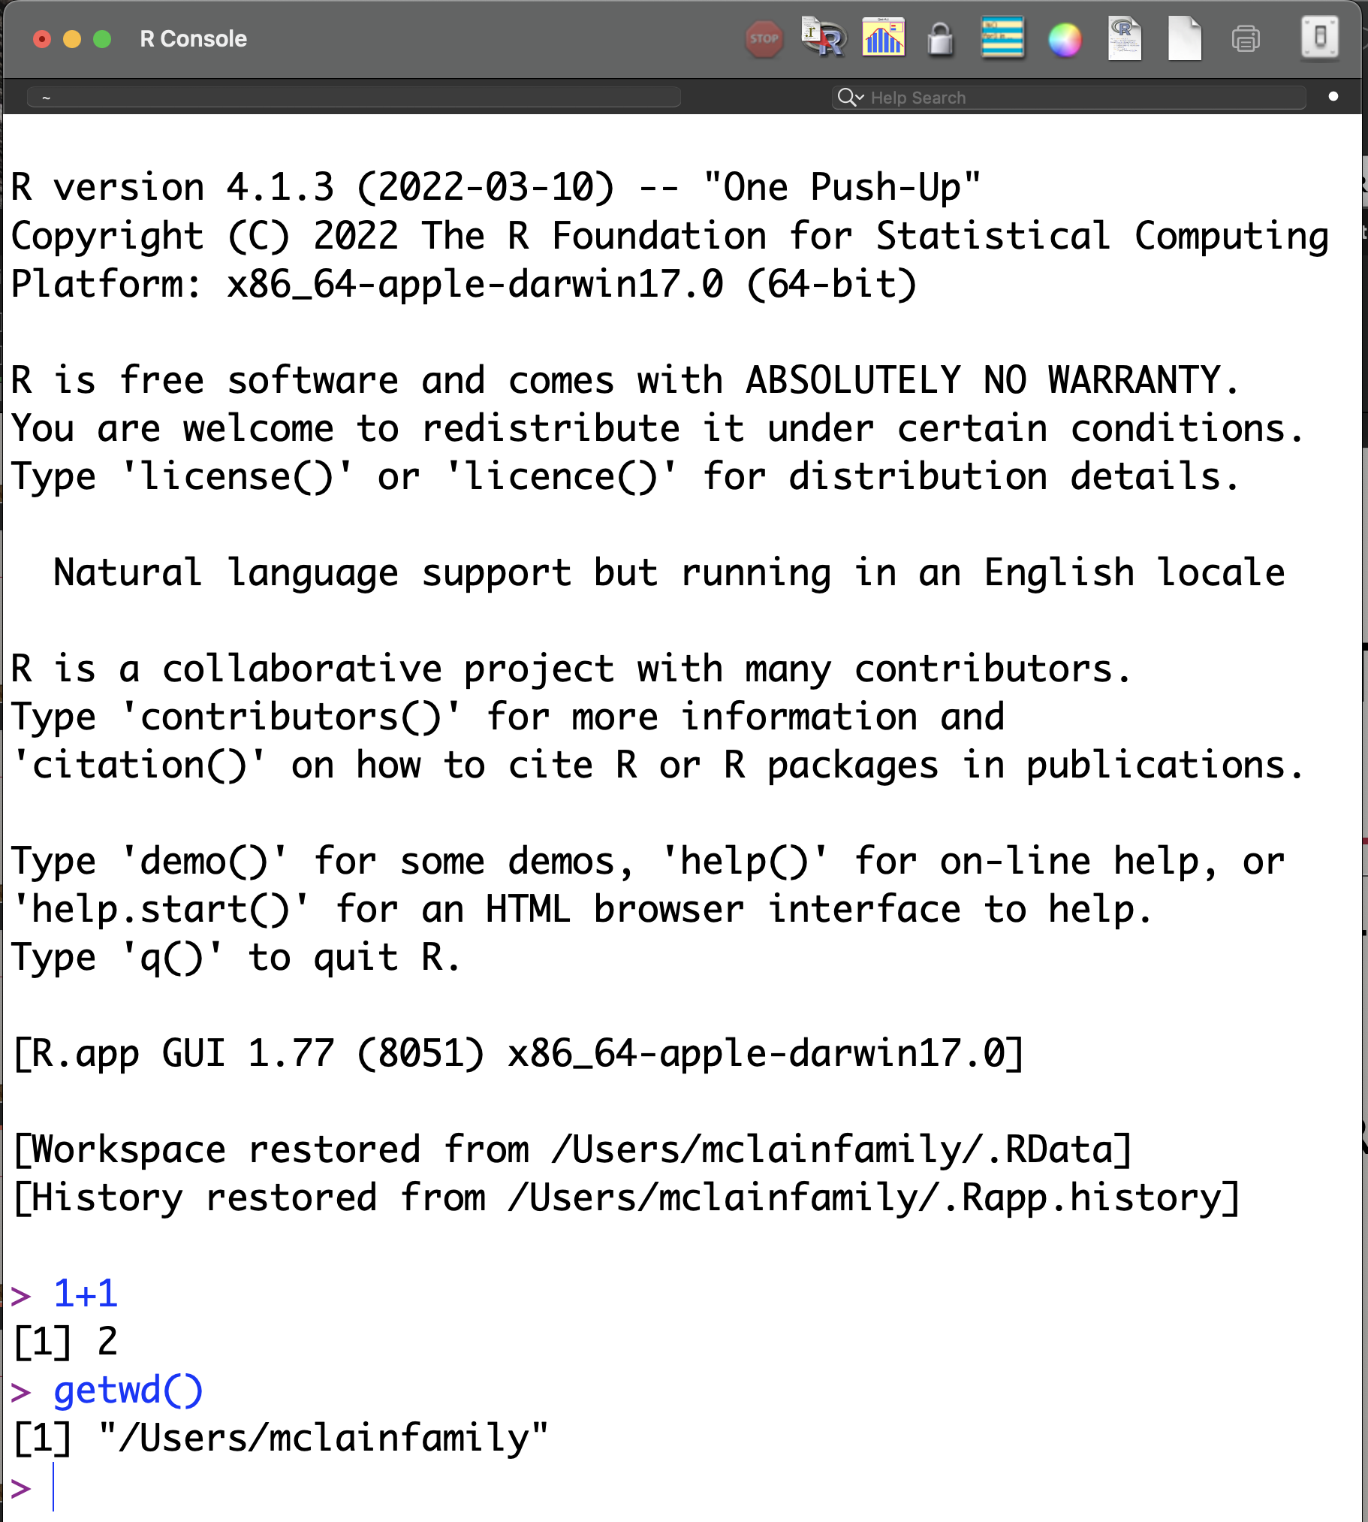
What Actions to Test– for Windows
R should give you the followings results:

Slide 18
RStudio

Slide 19
Where to Download RStudio?

Slide 20
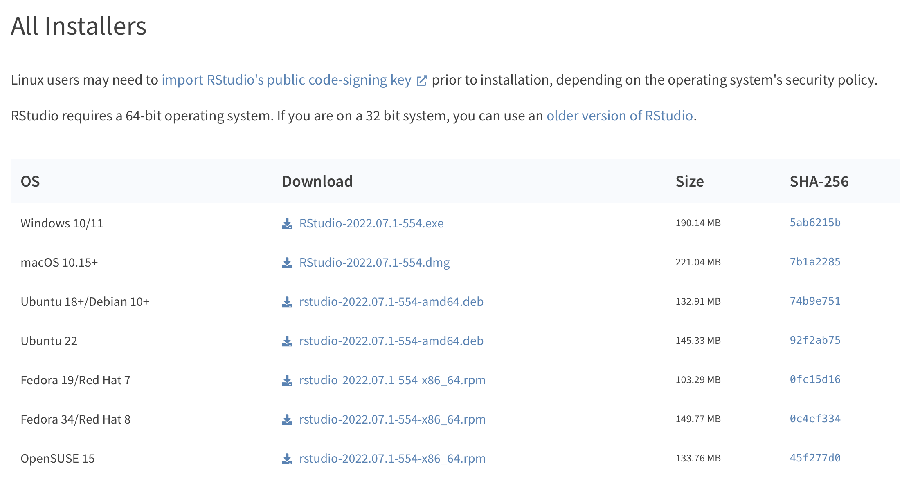
Where to Download RStudio - Choosing Mirror
Website: https://www.rstudio.com/products/rstudio/download/
Under “RStudio Desktop” click download and choose the appropriate version.

Slide 21
How to Install RStudio?

Slide 22
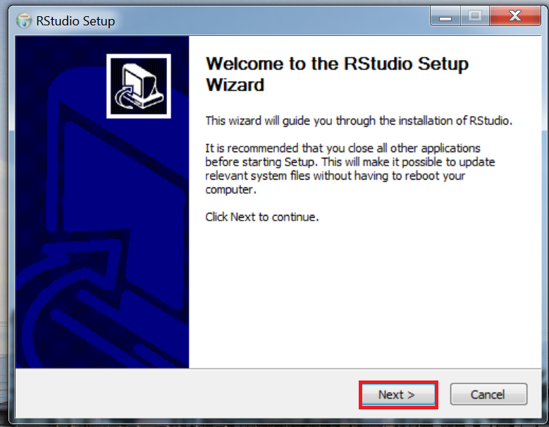
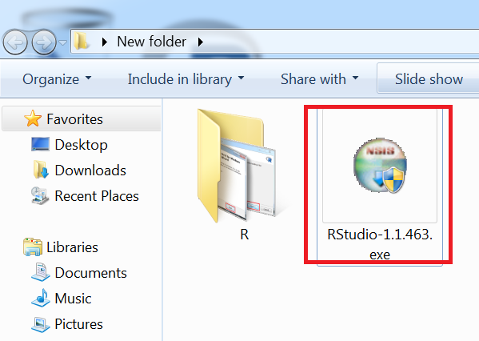
How to Install RStudio – for Windows
Step 1
Step 2
Double click the installation file you just downloaded
Click next

Slide 23
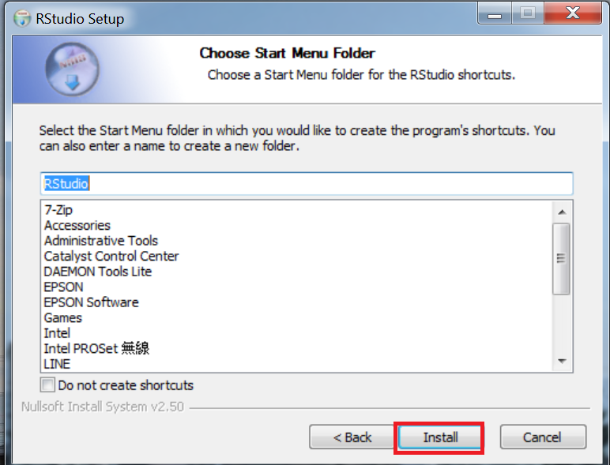
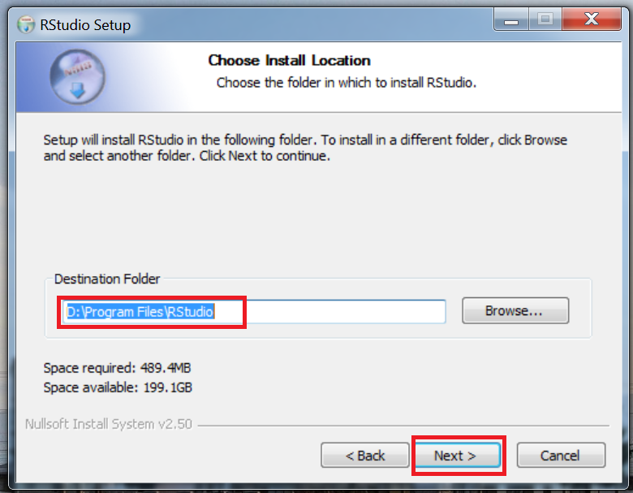
How to Install RStudio – for Windows
Step 3
Step 4
Choose destination folder then press next
Click install

Slide 24
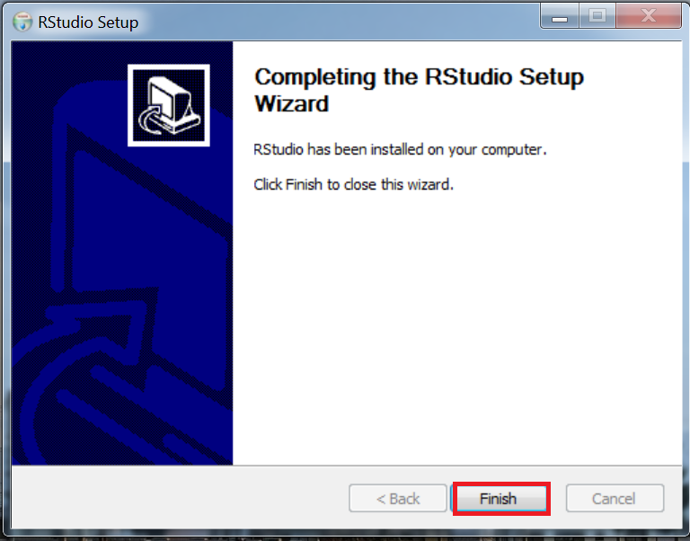
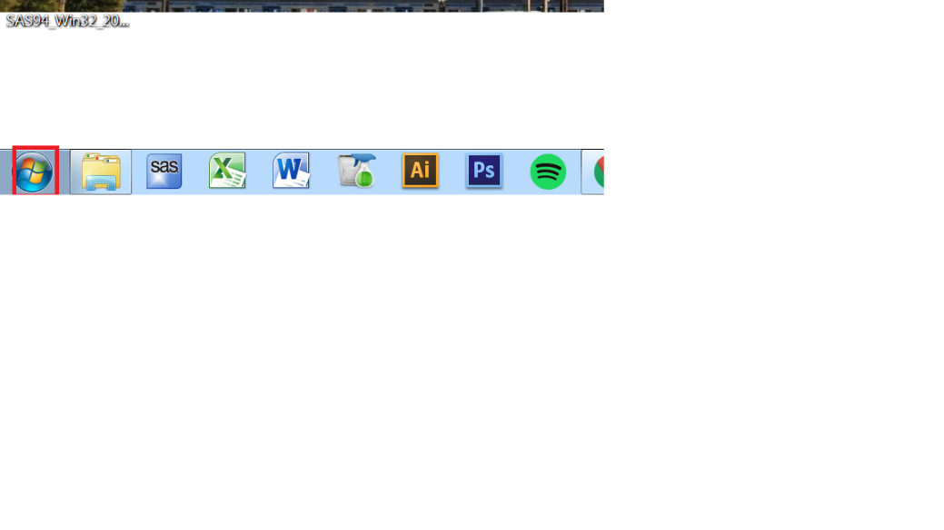
How to Install RStudio – for Windows
Step 5
Step 6 (Open Rstudio)
Click finish to complete the installation
Hit start

Slide 25
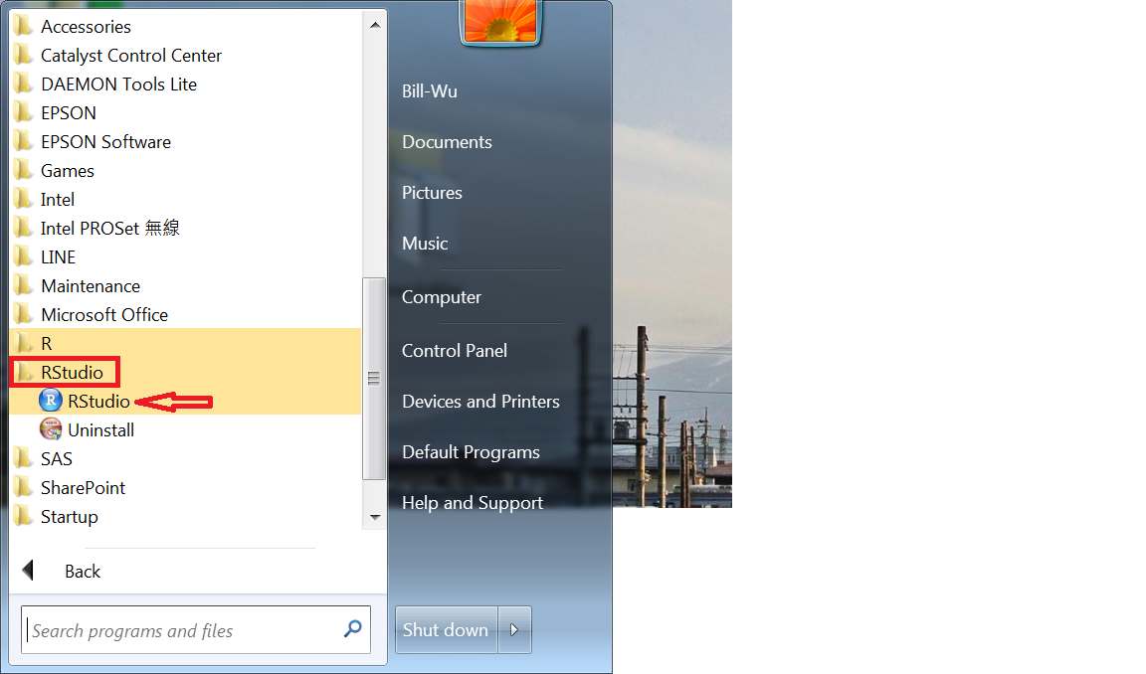
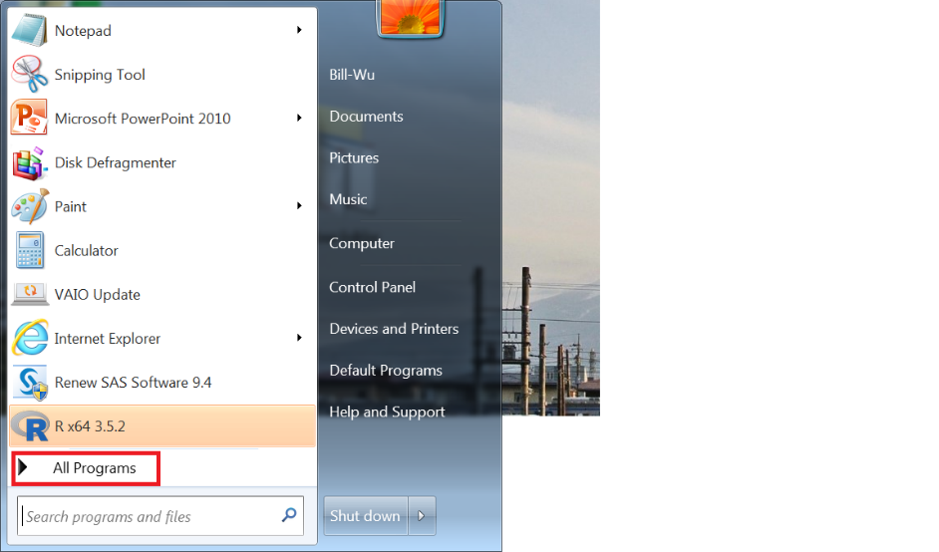
How to Install RStudio – for Windows
Step 7 (Open Rstudio)
Step 8 (Open Rstudio)
Select all programs
Find RStudio folder and hit RStudio to open

Slide 26
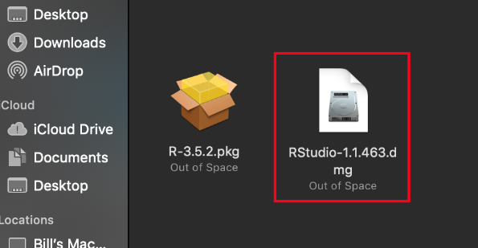
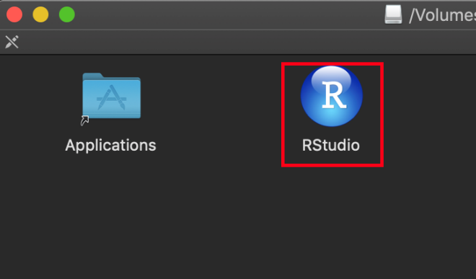
How to Install RStudio – for Mac
Double click the installation file you just downloaded
Double click RStudio to open it

Slide 27
What Actions to Test?

Slide 28
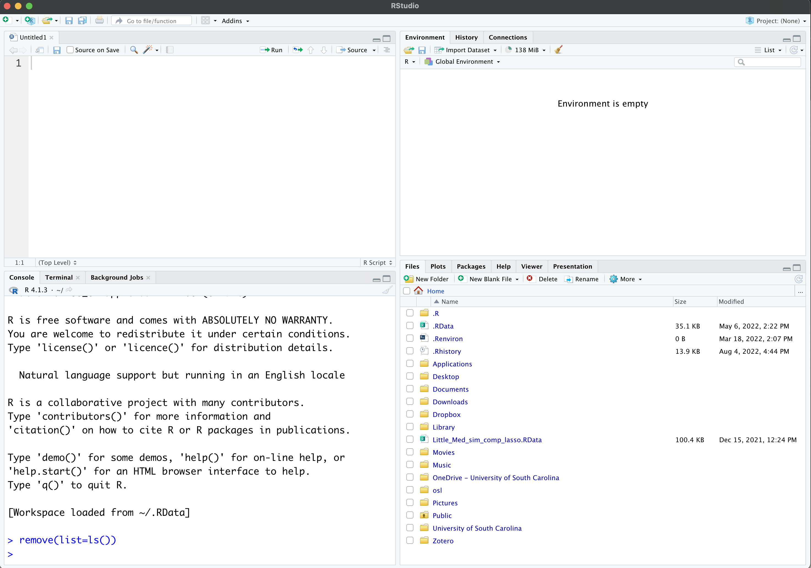
RStudio should look like this:
Editor/script
Objects
Graphs, files, and help
This is Console

Slide 29
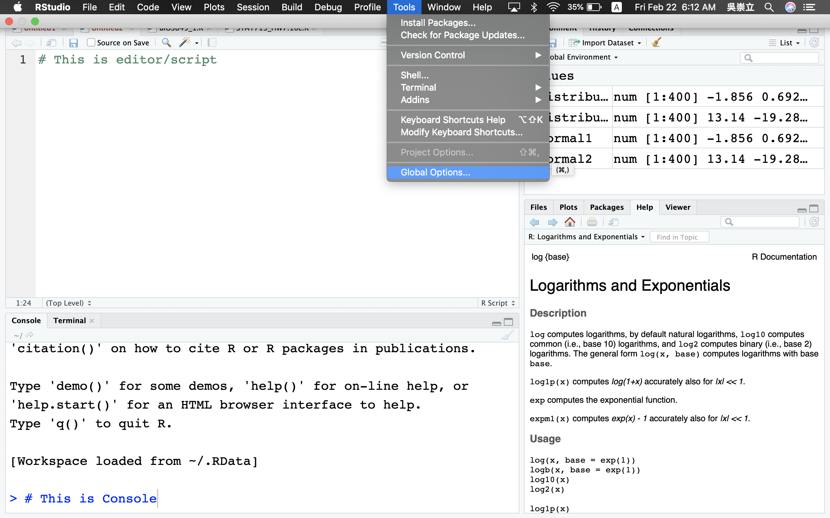
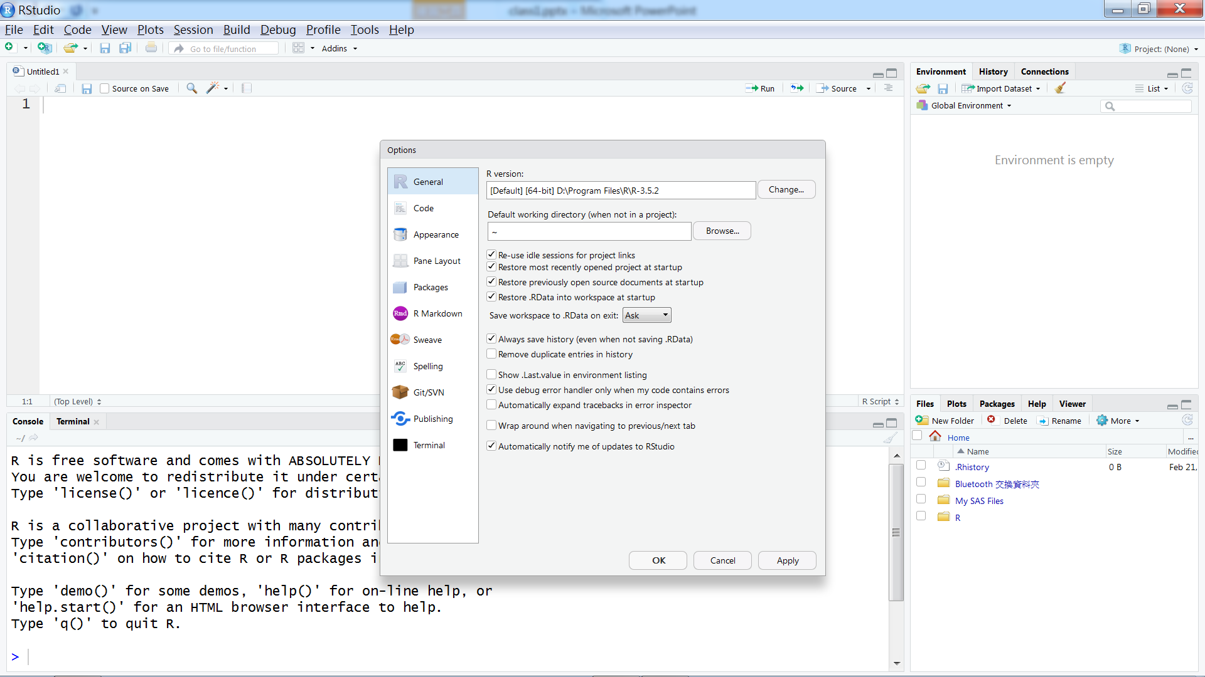
GUI Setting in RStudio
Where to Open
GUI Setting Interface

Slide 30
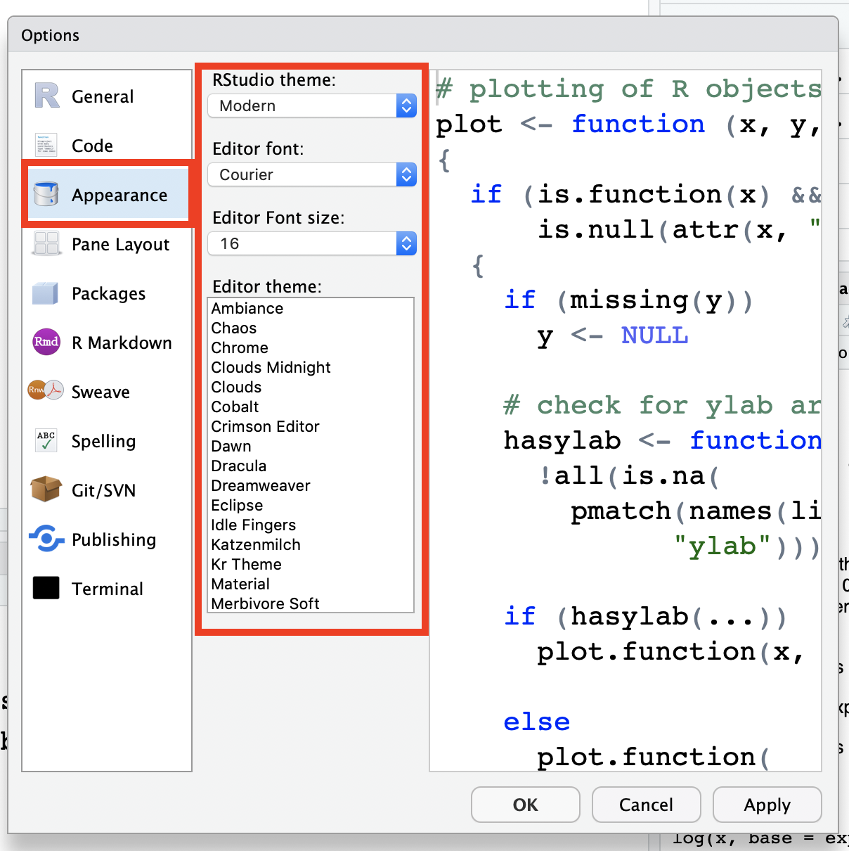
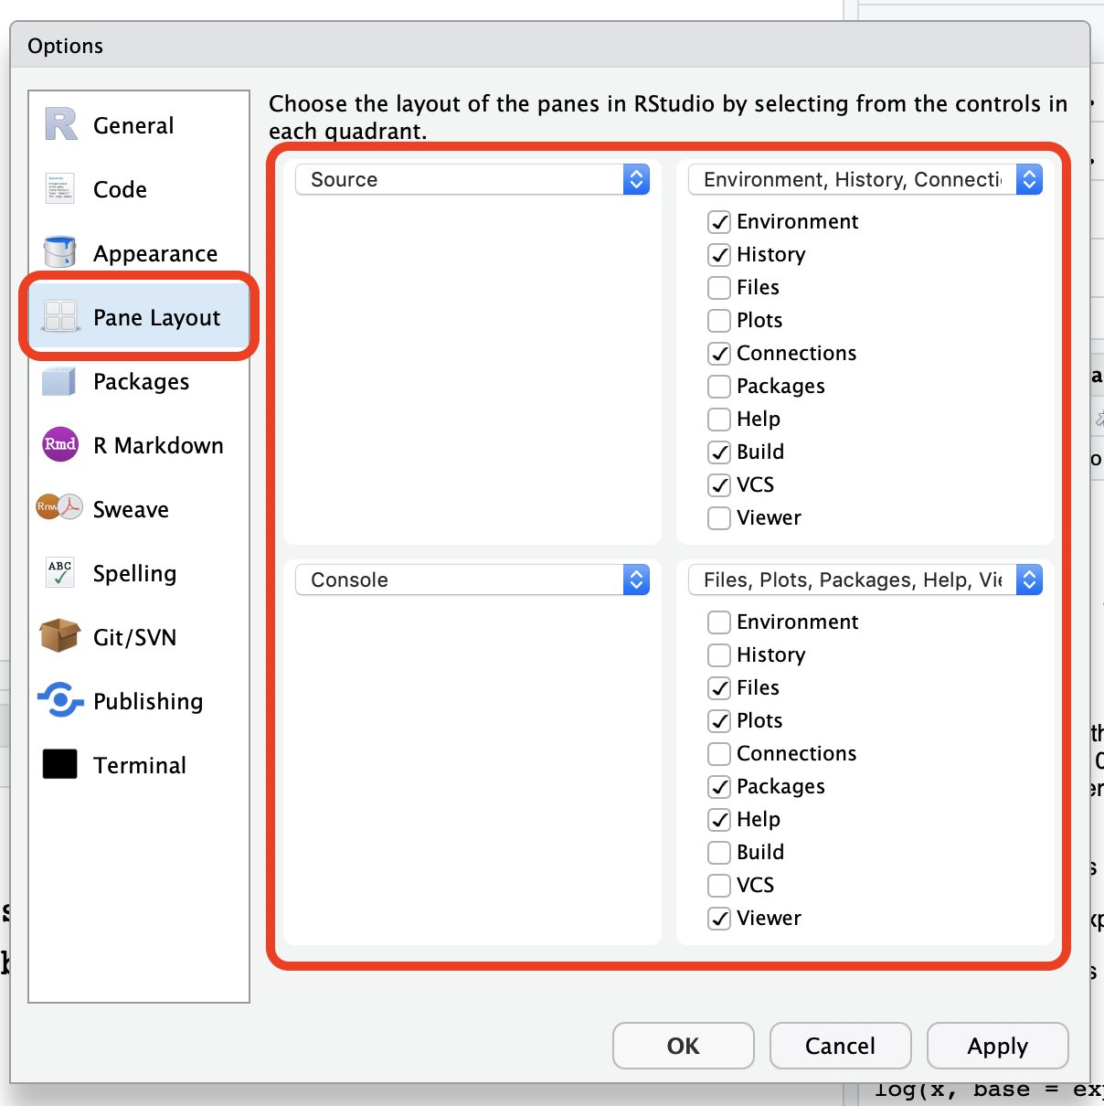
GUI Setting in RStudio - Options
Appearance: Adjust Font Style
Pane Layout: Arrange Pane

Slide 31
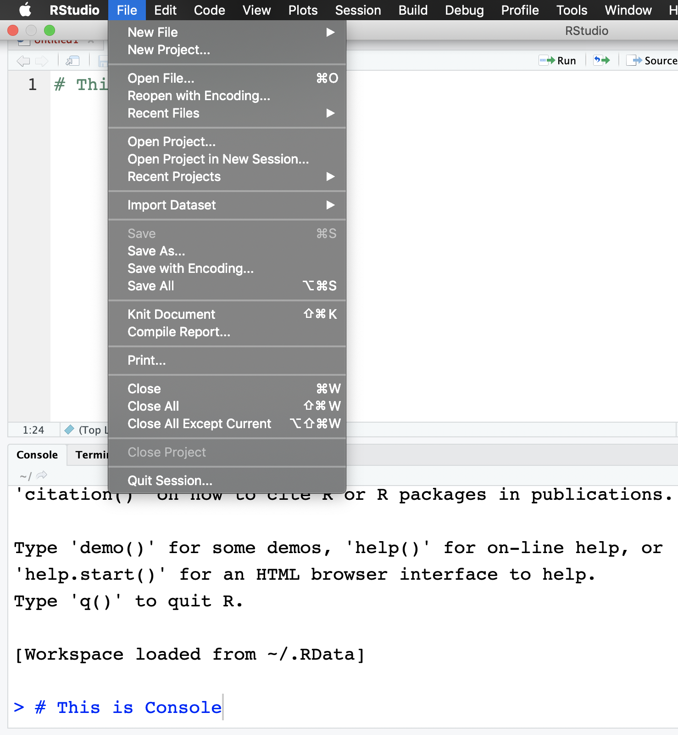
Saving and Opening Script in RStudio
Open script
Save script

Slide 32
Actions to Test
Submit the following code to R Console (please copy and paste)
1+1
getwd()
install.packages(“tidyverse”) (Note: smart quotes won’t work! Need to change.)

Slide 33
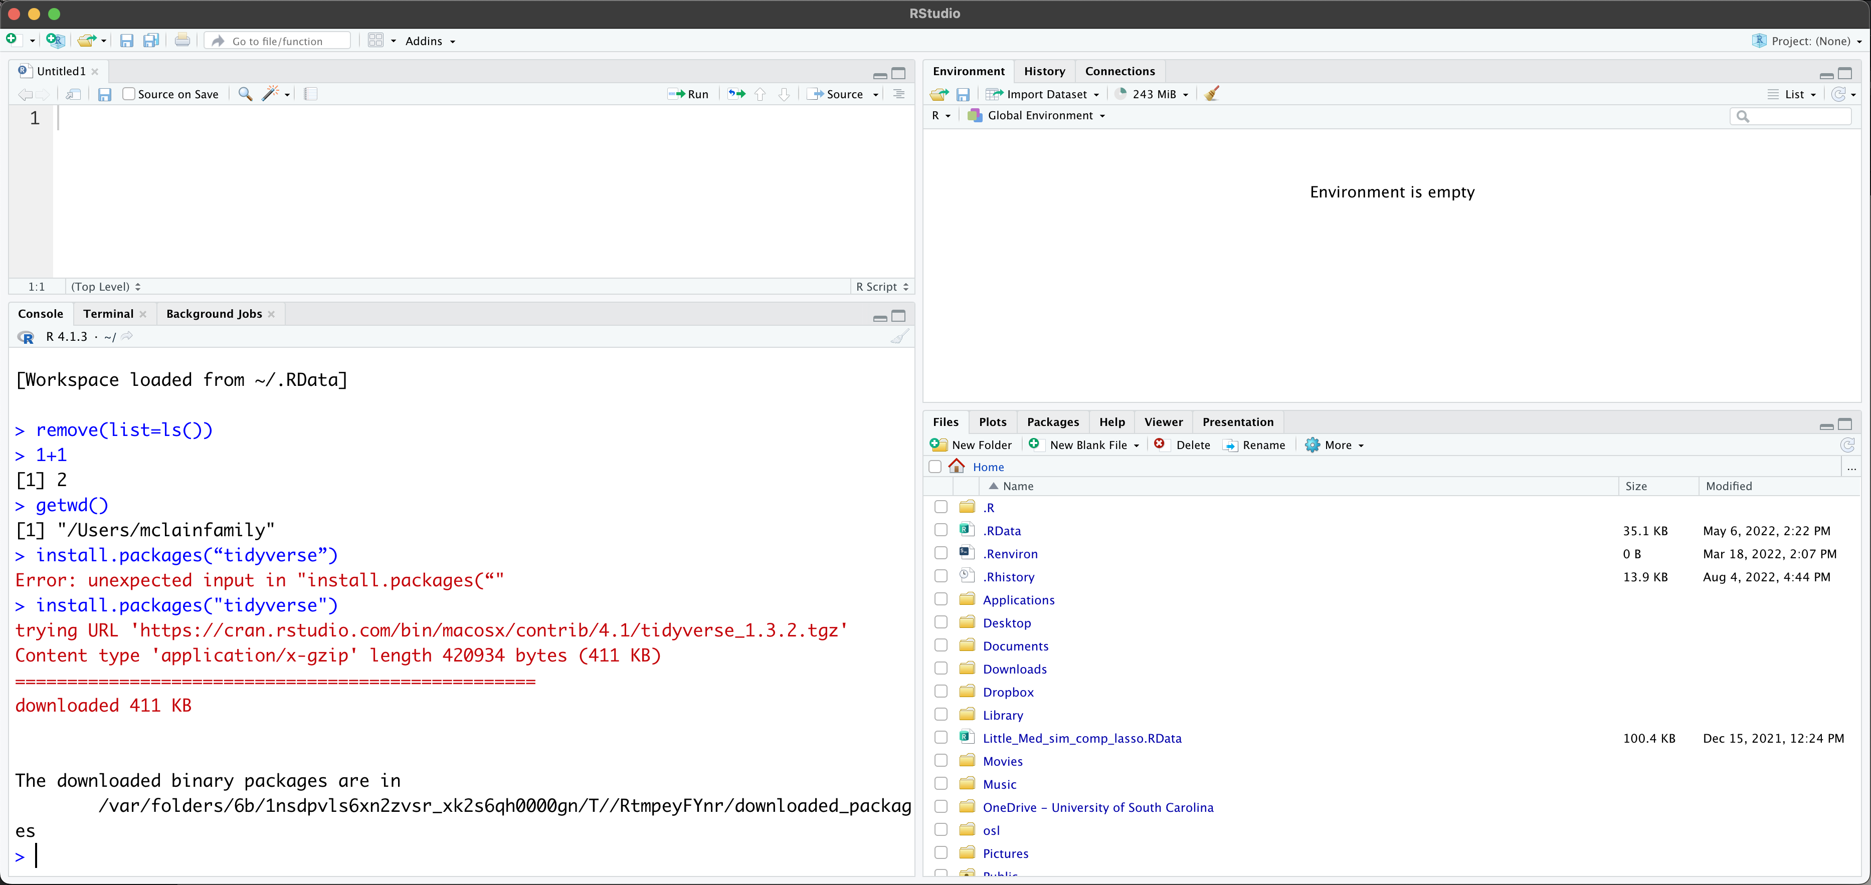
What Actions to Test
What you should get is:

Slide 34
Packages
Congrats! You’ve loaded your first package in R!
Base R (i.e., not using any external packages) is useful, but the real beauty of R is the user contributed packages.
there are > 10,000 packages available in R.
We have loaded tidyverse, which load multiple packages that we’ll use throughout the class including:
ggplot2 (for plotting),
dplyr (for data manipulations),
readr (for reading/writing)
tidyr (for tidying messy data)

